Slide 1

Engineering Problem Solving in Python
Austin R.J. Downey

Slide 2
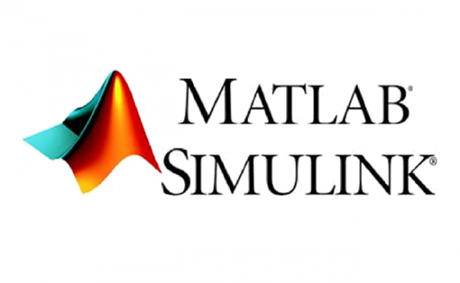





Languages for Scientific Computing
Wolfram Mathematica
open source “copies”
R (programming language)
GNU Octave
Scilab
2
Notes:
2

Slide 3
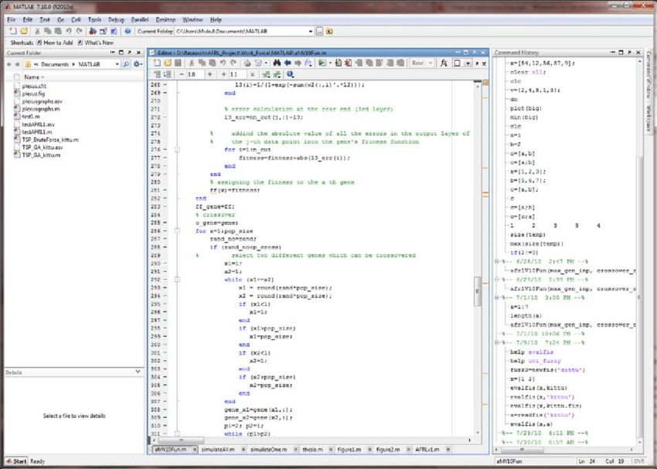
MATLAB in Engineering
Pros:
Works out of the box.
Code is well managed and packages don’t conflict.
Widely used in engineering and computing.
Well formulated for linear algebra with simple commands
Fast implementation of code for complex problem solving
Not at the bleeding edge of machine learning
Cons:
Not free as in speech, not free as in beer
Each module must be paid for separately
Not at the bleeding edge of machine learning
Difficult to keep license updated on multiple machines
Lets you write poorly structured code.
3
Notes:
3

Slide 4
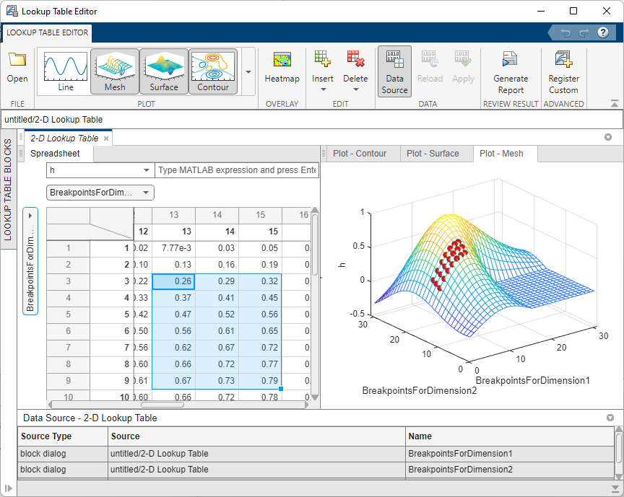
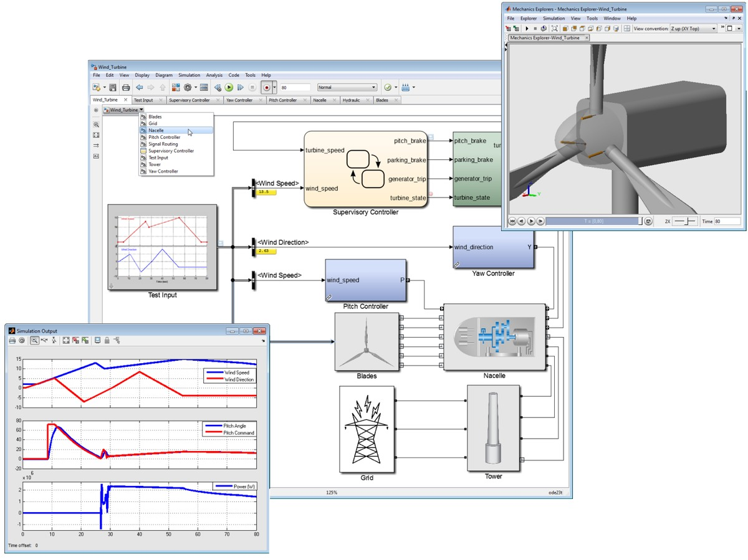
MATLAB in Engineering
Matlab, via matlab.com
Mcarone1, CC BY-SA 3.0 <https://creativecommons.org/licenses/by-sa/3.0>, via Wikimedia Commons
4
Notes:
4

Slide 5
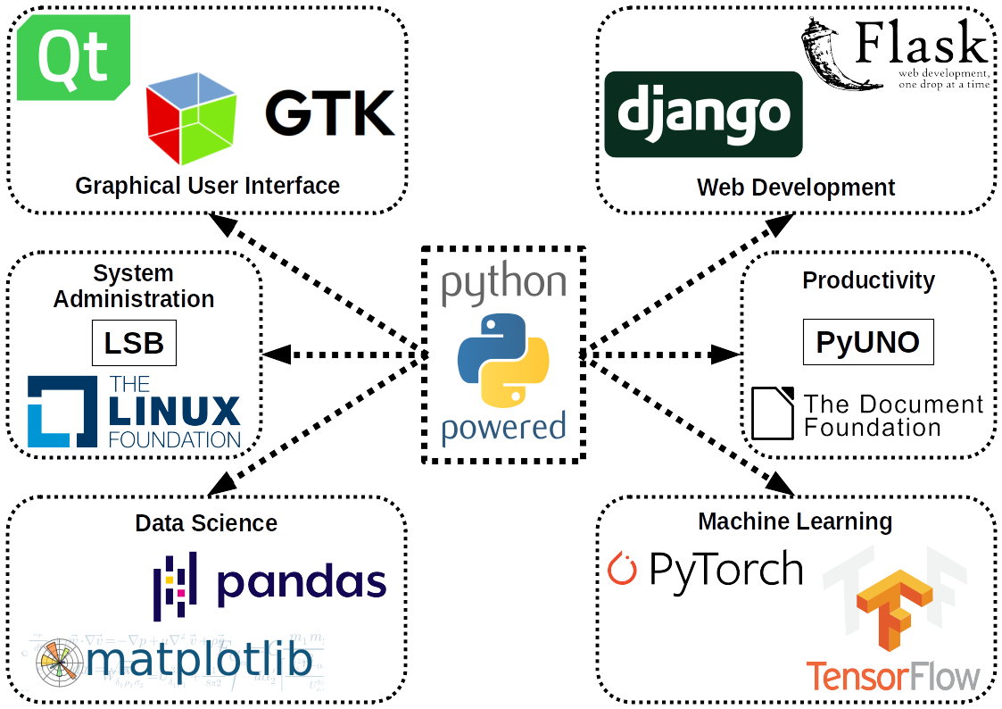

Python
Python is scripting language that can be used for Scientific Computing.
Guido van Rossum
https://upload.wikimedia.org/wikipedia/commons/6/66/Guido_van_Rossum_OSCON_2006.jpg
Named after Monty Python's Flying Circus
5
Максим Пе, CC BY-SA 4.0 <https://creativecommons.org/licenses/by-sa/4.0>, via Wikimedia Commons
Guido van Rossum
Notes:
5

Slide 6
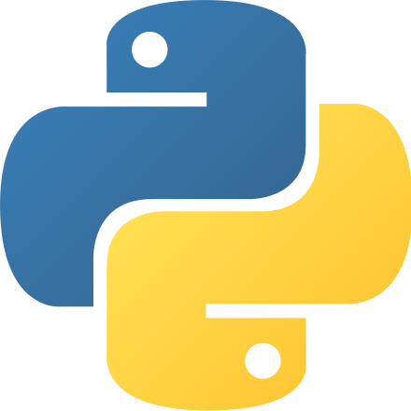
Python
Python is an interpreted (mostly), high-level, general-purpose programming language with an object-oriented approach.
Interpreted language: is a type of programming language for which its instructions execute directly and freely, without previously compiling a program into machine-language instructions.
High-level: a programming language with strong abstraction from the details of the computer.
General-purpose: is a programming language designed to be used for writing software in the widest variety of application domains (a general-purpose language).
Object-oriented: is a programming paradigm based on the concept of "objects", which can contain data, in the form of fields (often known as attributes or properties), and code, in the form of procedures (often known as methods).
6
Guido van Rossum
Notes:
6

Slide 7
Python
Python's design philosophy emphasizes code readability with its notable use of significant whitespace. Python is dynamically typed and garbage-collected.
Code readability: refers to the ease with which a human reader can comprehend the purpose, control flow, and operation of source code. It affects the aspects of quality, including portability, usability and most importantly maintainability.
Whitespace: refers to the usage of whitespace in typing code. In Python, the information about blocks are expressed by their indentation.
Dynamically Typed: refers to languages execute many common programming behaviors at runtime that static programming languages perform during compilation. For us, this means defining variable types.
Garbage-Collected: is a form of automatic memory management. The garbage collector attempts to reclaim garbage, or memory occupied by objects that are no longer in use by the program.
7
Guido van Rossum
Notes:
7

Slide 8
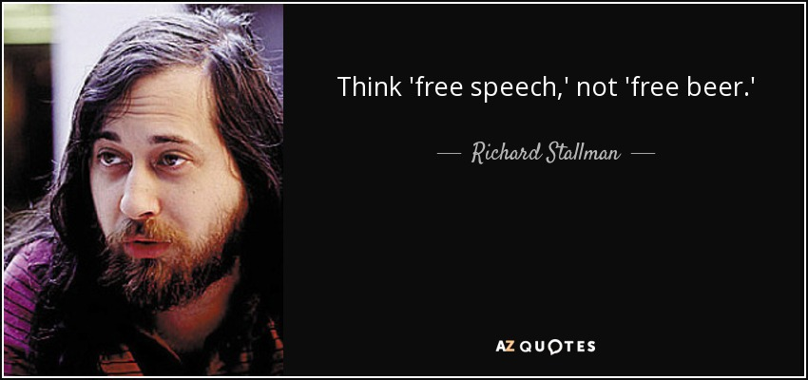

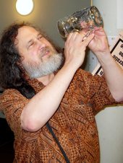
Python is Free as in beer and Free as in speech
Free beer (never)
Free speech (First Amendment to the United States Constitution; December 15, 1791)
8
Notes:
8

Slide 9
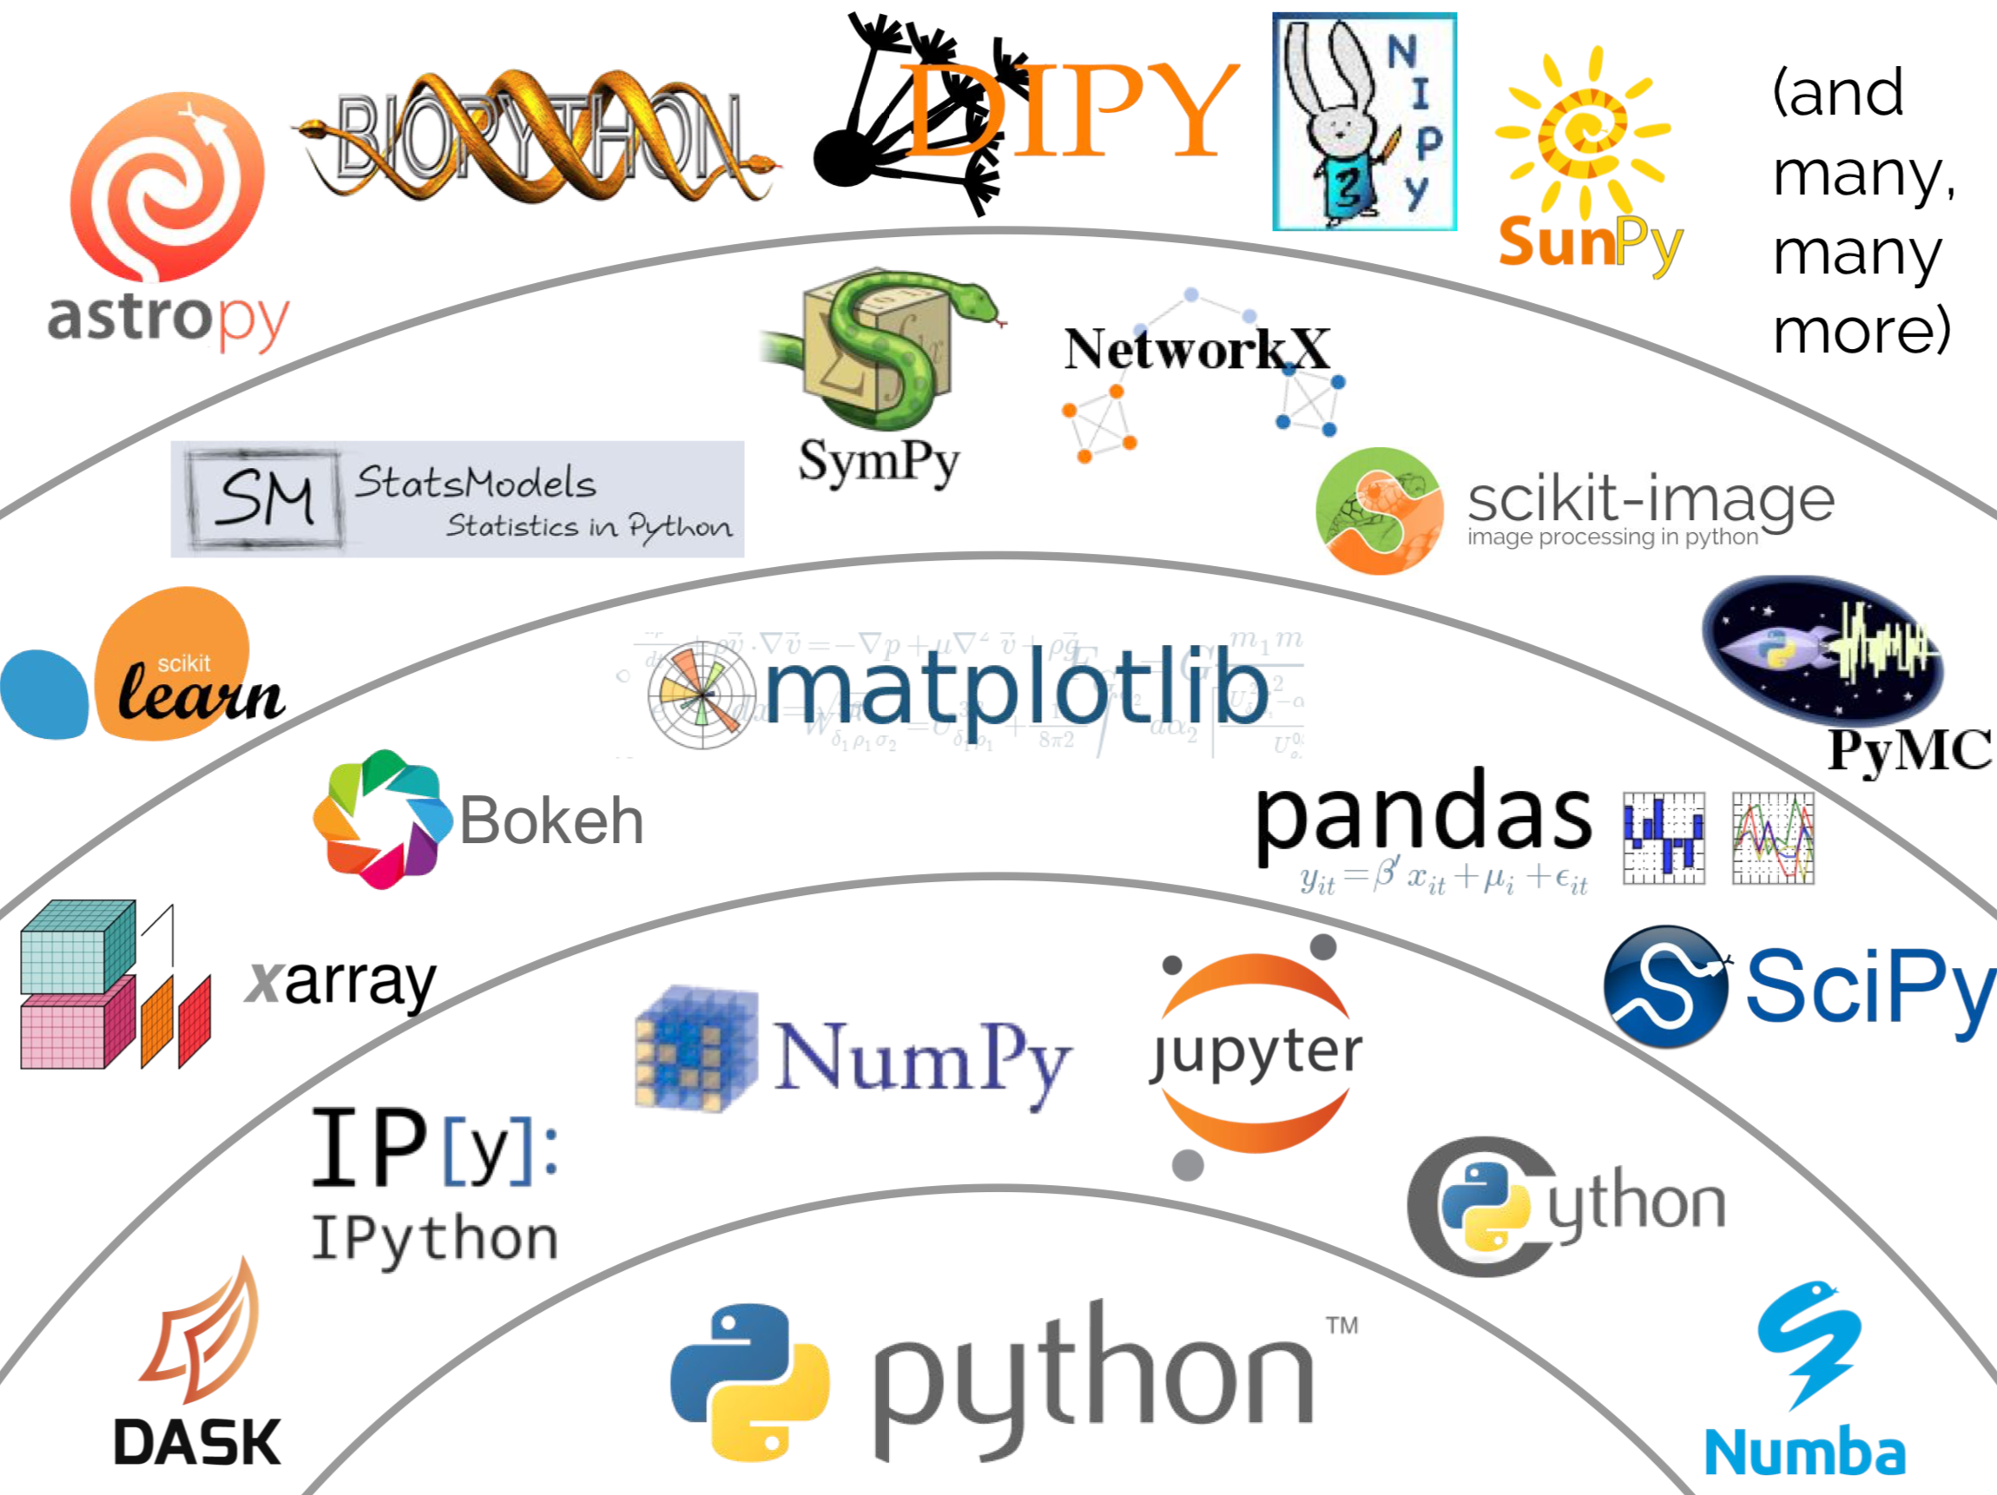
Python is a language, we use an ecosystem
In this class we will focus on a limited subset of this ecosystem:
IPython: command shell for interactive computing in Python.
Spyder: cross-platform integrated development environment (IDE) for scientific programming in Python.
Numpy: library adding support for multi-dimensional arrays.
SciPy: library used for scientific computing and technical computing.
matplotlib: API focused on plotting
scikit-learn: library for machine learning.
TensorFlow: symbolic math library, used for neural networks.
9
Notes:
9

Slide 10

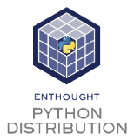
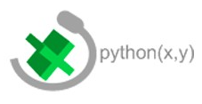
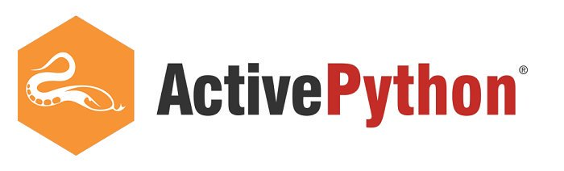
Python Distributions
A distribution is a group of packages that are assembled and more-or-less work well together. Some of these are free (beer/speech) while for others there are required service packs for their use. In this class, we will use Anaconda from Anaconda, Inc. Anaconda is a free and open-source distribution for scientific computing.
10
Notes:
10

Slide 11
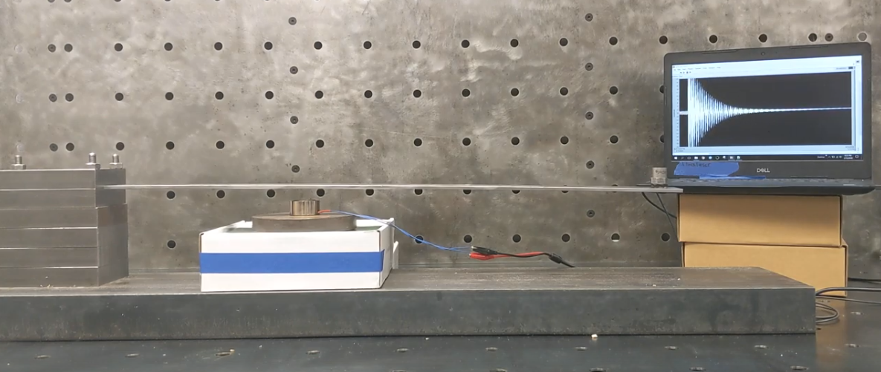

Example #1 – Plot beam vibration data in Python
https://github.com/ARTS-Laboratory/dataset-free-vibration-of-cantilever-beam
11
Notes:
11

Slide 12
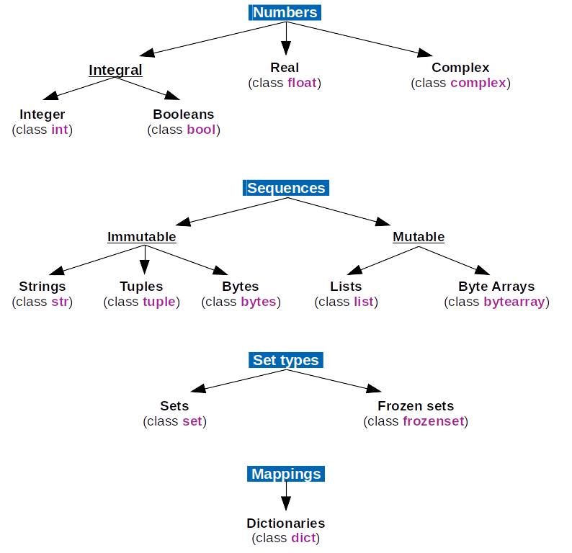
Python
Key types in Python are:
Numbers:
Integer
Booleans
Real
Sequences:
Strings ‘’ or “”
Lists [ ]
Tuples ( )
Mappings
Dictionaries { }
12
Notes:
12

Slide 13
Example #2 – Pure Python
13
Notes:
13

Slide 14
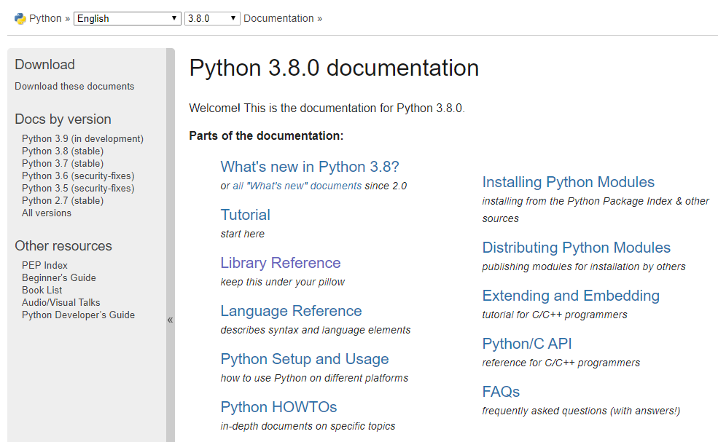
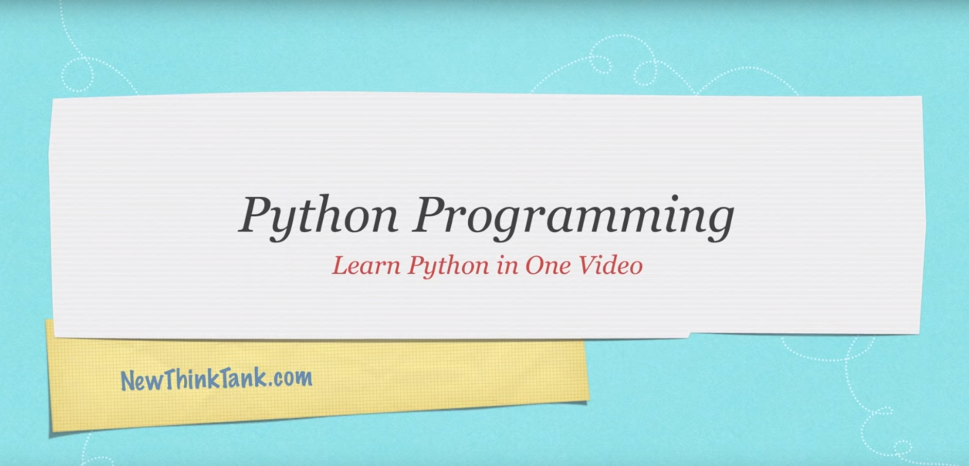
Additional Python Resources
Python documentation
https://docs.python.org/3.8/
YouTube : “Python Programming” by Derek Banas
https://www.youtube.com/watch?v=N4mEzFDjqtA
And many many more……………………
14
Notes:
14

Slide 15
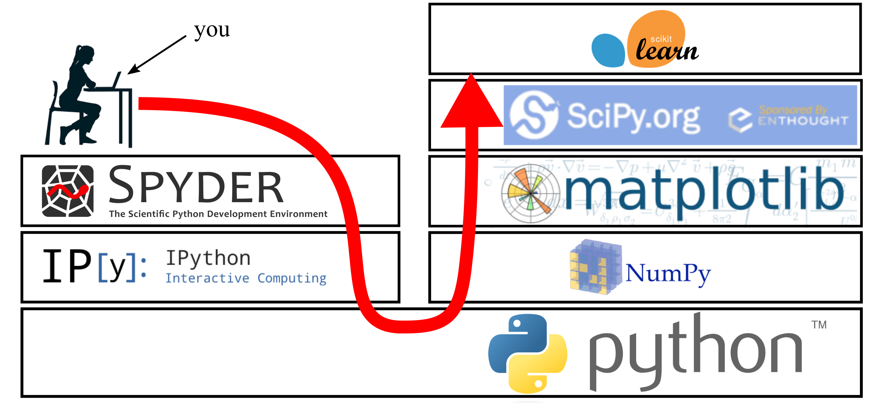
Our Ministack
15
Notes:
15

Slide 16

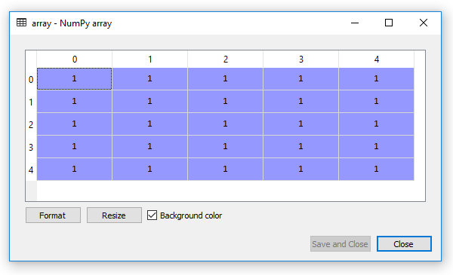
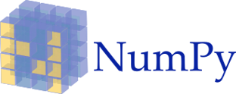
NumPy (Numerical Python)
Python does not support arrays or matrices and its mathematical support is limited and slow.
NumPy was created to add support for arrays and matrices to Python.
Numpy adds support for high-level mathematical functions to operate on these arrays and matrices.
Python documentation can be found at https://numpy.org/doc/1.17/reference/index.html
Numpy is limited in scope and is only designed to add numerical computing to phyton.
NumPy underpins nearly every scientific computing platform created for Python.
16
Notes:
16

Slide 17
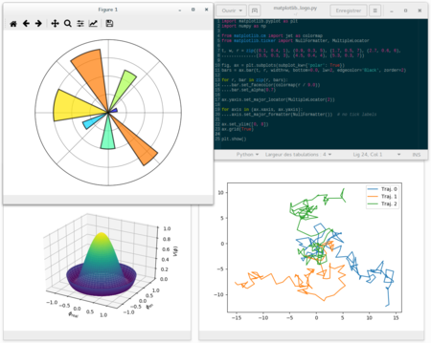
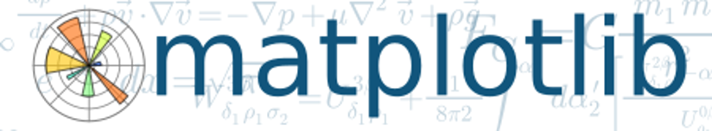
Mapplotlib
Matplotlib is a plotting library for Python.
At one point it was formed by combining multiple liberies (pyplot and pylab). We will use pyplot as pylabs use is discouraged.
Pyplot is a Matplotlib module which provides a MATLAB-like interface.
matplotlib documentation can be found at https://matplotlib.org/3.1.1/api/index.html
Pyplot documentation can be found at https://matplotlib.org/3.1.1/api/_as_gen/matplotlib.pyplot.html#module-matplotlib.pyplot
17
Notes:
17

Slide 18
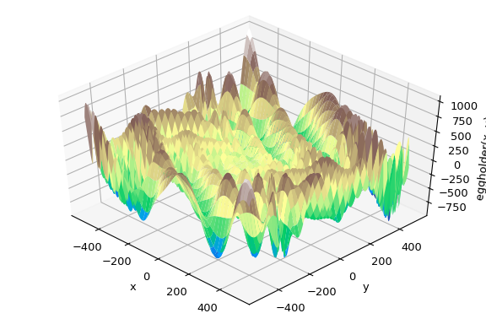
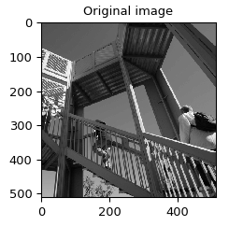
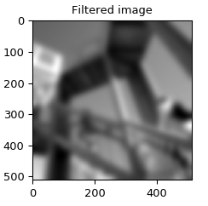

SciPy (not ScientificPython but close enough)
Optimization (scipy.optimize)
SciPy is a Python library used for scientific computing and technical computing.
SciPy builds on the NumPy array class and the capabilities of matplotlib.
SciPy contains modules for optimization, linear algebra, integration, interpolation, special functions, FFT, signal and image processing, ODE solvers and other tasks common in science and engineering.
SciPy and NumPy contain some duplicate capabilities (e.g., FFT). A common way to look as this is that the NumPy version is more bare-bones than the equivalent SciPy version.
SciPy documentation can be found at https://docs.scipy.org/doc/scipy/reference/
Signal Processing (scipy.signal)
18
Notes:
18

Slide 19
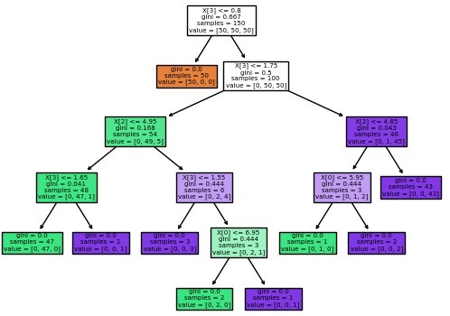
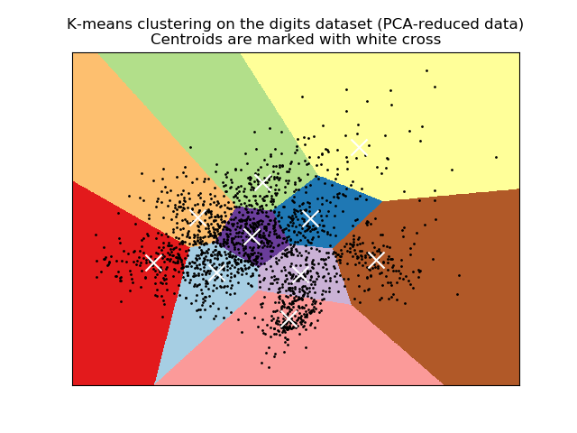

scikit-learn (also called sklearn)
Decision Trees
Sklearn is a machine learning library for Python.
It features various classification, regression and clustering algorithms including support vector machines, random forests, gradient boosting, k-means and DBSCAN.
Sklearn is designed to interoperate with the Python numerical and scientific libraries NumPy and SciPy.
Sklearn documentation can be found at
https://scikit-learn.org/stable/user_guide.html
Clustering
19
Notes:
19

Slide 20
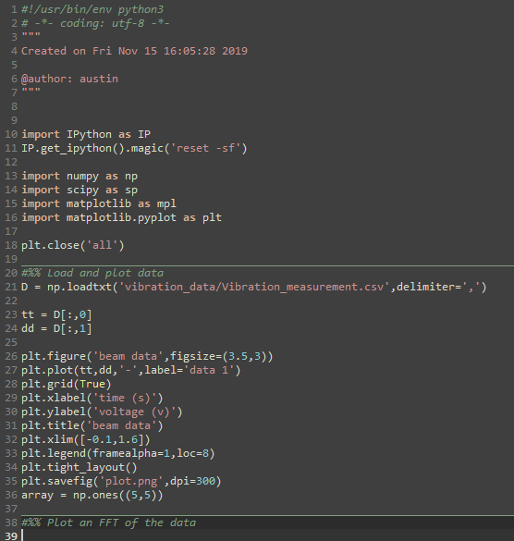
Conclusions:
Python is great, but not useful for scientific computing.
Scientific modules have been developed for python to expand its usefulness into scientific computing. The major packages are:
NumPy
Matplotlib
Pyplot
SciPy
Sklearn
We code in a Integrated Development Environment (IDE) of which there are lots, we used Spyder in our examples.
20
Notes:
20

Slide 21
Example #3 – Data processing (FFT) in SciPy
Notes:
21

Slide 22
Thank You for Your Time
Name: Austin R.J. Downey
Title: Associate Professor
Email: austindowney@sc.edu
Lab GitHub: github.com/arts-laboratory

